Slide 1

Notes:
After this video I can probably just go straight to the questions because it summarized nearly everything we did. This paper is a database paper. I will not reveal any detailed plans of our future work just yet (hopefully there will soon follow more papers in which you can read about those). I would rather like to present to you a possible new way of acquiring eye videos.
why is this database so special, especially to me, what is new in it and how it could be exploited in eye tracking.

Slide 2

http://www.uef.fi/fi/web/spectral/speed
Notes:
After this video I can probably just go straight to the questions because it summarized nearly everything we did. This paper is a database paper. I will not reveal any detailed plans of our future work just yet (hopefully there will soon follow more papers in which you can read about those). I would rather like to present to you a possible new way of acquiring eye videos.
why is this database so special, especially to me, what is new in it and how it could be exploited in eye tracking.

Slide 3
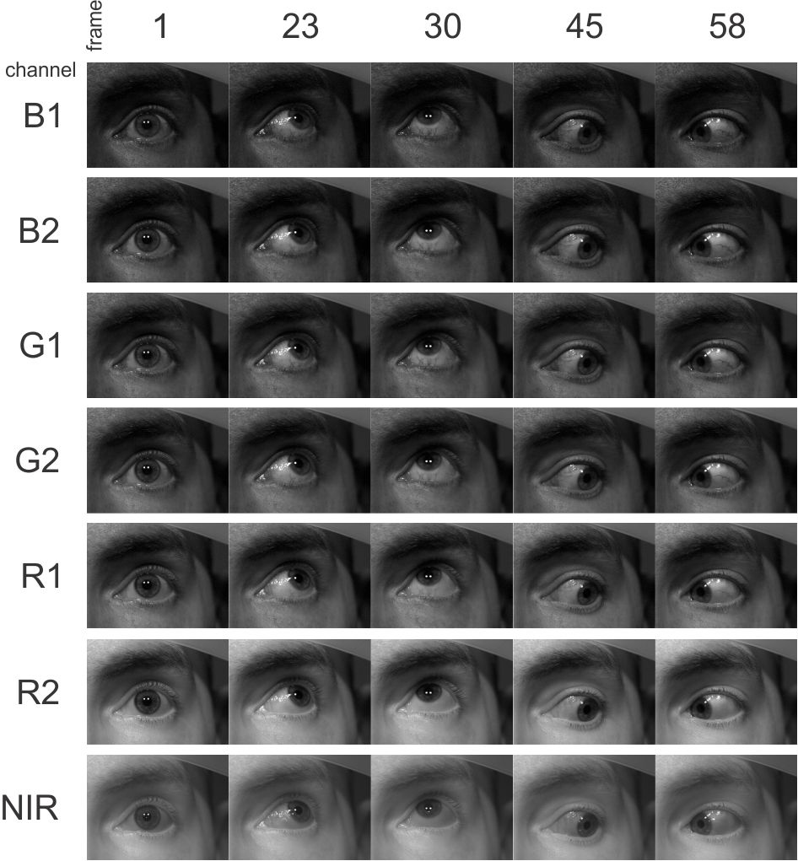
SPEED – SPectral Eye vidEo Database
Ana Gebejes, Pauli Fält, Roman Bednarik, Markku Hauta-Kasari
University of Eastern Finland Joensuu, Finland
ana.gebejes@uef.fi

Slide 4
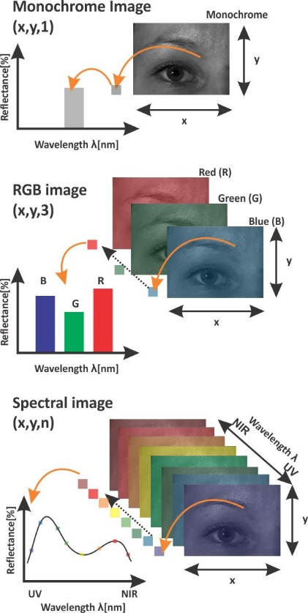
Spectral imaging
Notes:
Video of the eye movement. Maybe if I have time I can film the whole setup and have the video shown here. 1min max

Slide 5
Examples
Ngo, Hau T., et al. "Design and implementation of a multispectral iris capture system." 2009 Conference Record of the Forty-Third Asilomar Conference on Signals, Systems and Computers. IEEE, 2009.
Notes:
Examples Talk about the biometrics and other application and then say the assumption we have. Tell about reflectance as a property of an object
These signatures can be exploited to create new methodologies for imaging, training, analysis and interpretation of eye tracking data in harsh conditions.

Slide 6
Examples
Crihalmeanu, Simona, and Arun Ross. "Multispectral scleral patterns for ocular biometric recognition." Pattern Recognition Letters 33.14 (2012): 1860-1869.

Slide 7
We hypothesize that there is a benefit of exploiting multiple wavelengths for the purposes of eye-movement tracking.
Spectral signatures can be exploited to create new methodologies for improving imaging, training, analysis and interpretation of eye tracking data in harsh conditions.

Slide 8
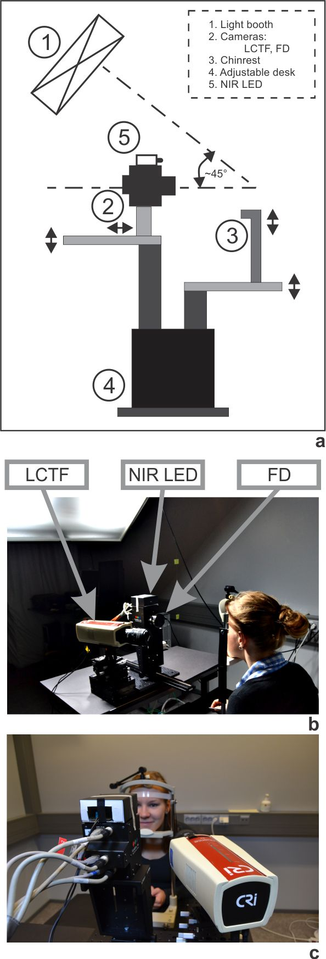
51 channel spectral images
Notes:
The first device we used for our database is a classical example of a device you cannot use to spectrally image moving objects because it is based on scanning. However the results we get from it are a very valuable densely samples ground truth. From these we can see the spectrum of the main features. we call these signatures

Slide 9
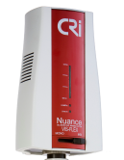
51 channel spectral images
LCTF
450-950 nm 10nm step
51 channel
Notes:
The first device we used for our database is a classical example of a device you cannot use to spectrally image moving objects because it is based on scanning. However the results we get from it are a very valuable densely samples ground truth. From these we can see the spectrum of the main features. we call these signatures

Slide 10
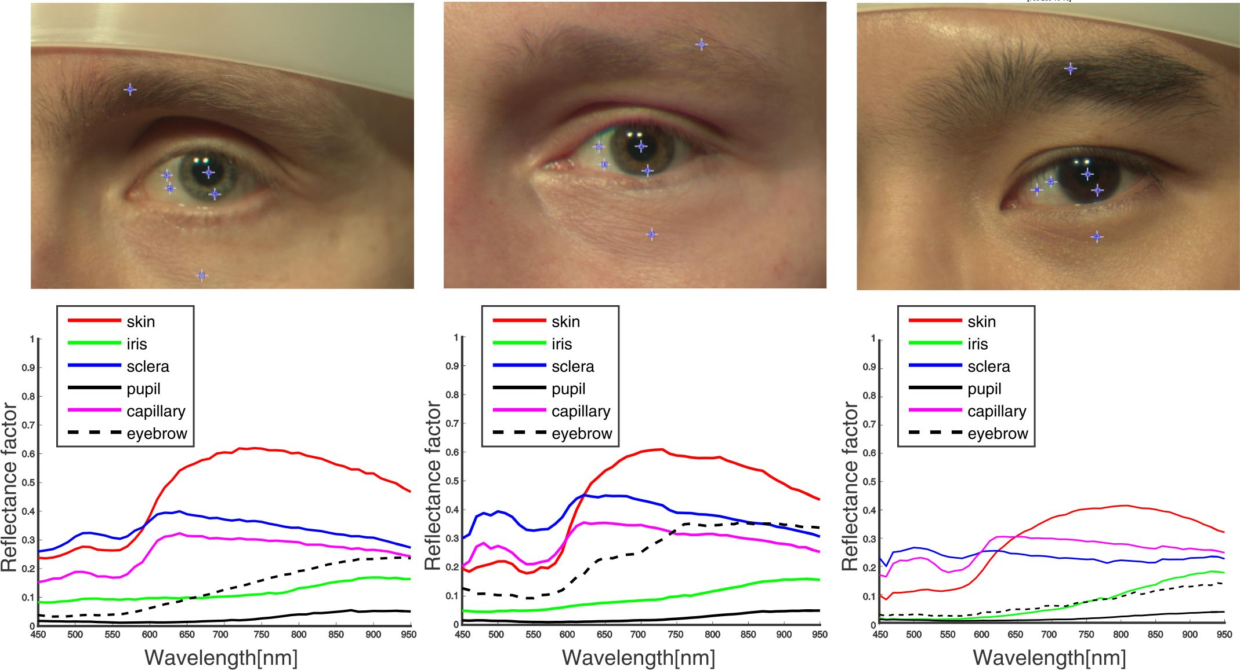
Spectral ground truth
Notes:
The first device we used for our database is a classical example of a device you cannot use to spectrally image moving objects because it is based on scanning. However the results we get from it are a very valuable densely sampled ground truth. From these we can see the spectrum of the main features. we call these signatures. It is common practice to collect data from more expensive and high accuracy devices in order to exploit it for optimization and new technology creation. By understanding the signatures we can pinpoint the optimal spectral bands to optimize the tech to find those.

Slide 11
Spectral ground truth
Notes:
The first device we used for our database is a classical example of a device you cannot use to spectrally image moving objects because it is based on scanning. However the results we get from it are a very valuable densely sampled ground truth. From these we can see the spectrum of the main features. we call these signatures. It is common practice to collect data from more expensive and high accuracy devices in order to exploit it for optimization and new technology creation. By understanding the signatures we can pinpoint the optimal spectral bands to optimize the tech to find those.

Slide 12
Spectral ground truth
Notes:
The first device we used for our database is a classical example of a device you cannot use to spectrally image moving objects because it is based on scanning. However the results we get from it are a very valuable densely sampled ground truth. From these we can see the spectrum of the main features. we call these signatures. It is common practice to collect data from more expensive and high accuracy devices in order to exploit it for optimization and new technology creation. By understanding the signatures we can pinpoint the optimal spectral bands to optimize the tech to find those.

Slide 13
With LCTF we cannot capture movement!
However there is a solution!

Slide 14
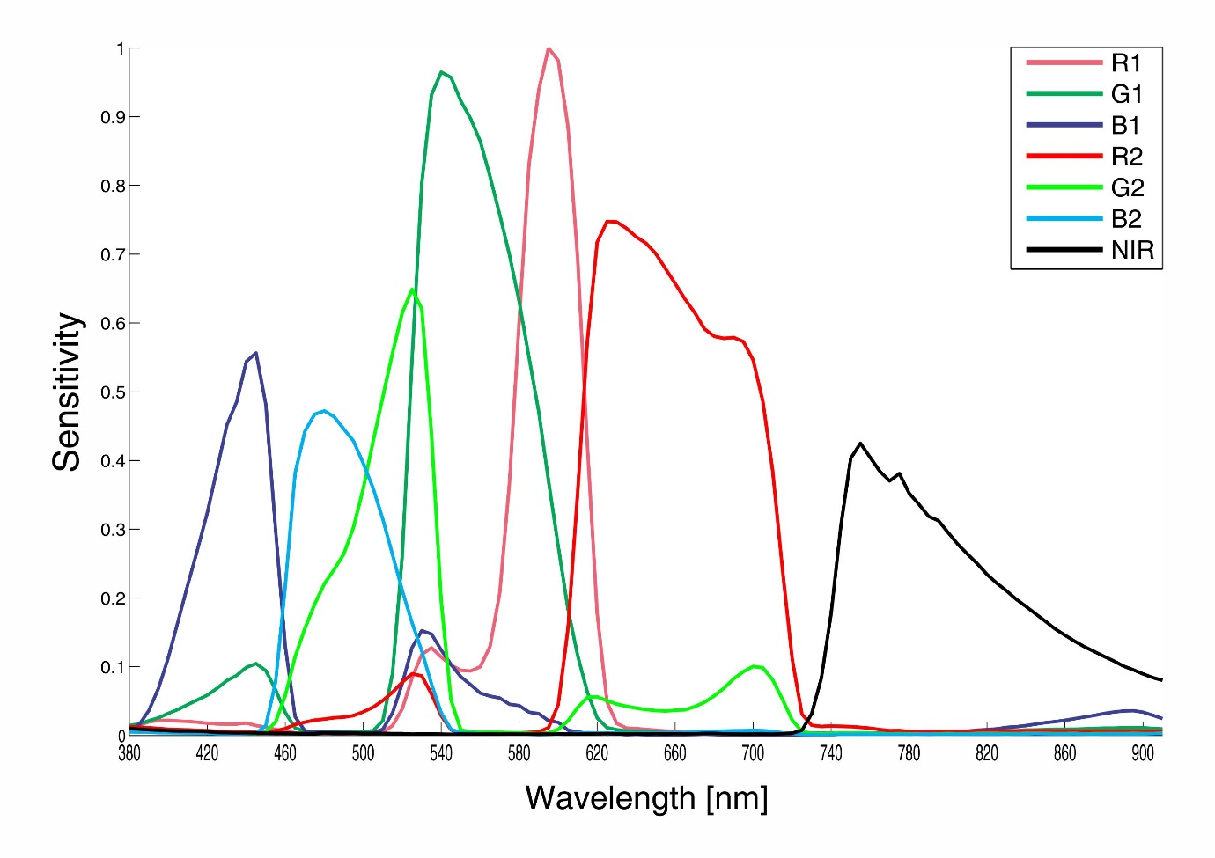
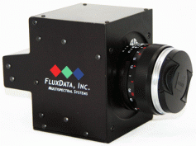
7 channel spectral video
Ana Gebejes, Joni Orava, Niko Penttinen, Ville Heikkinen, Jouni Hiltunen, and Markku Hauta-Kasari 2014. Color and Image Characterization of a Three CCD Seven Band Spectral Camera. In Image and Signal Processing, pp. 96-105. Springer International Publishing

Slide 15
7 channel spectral video

Slide 16
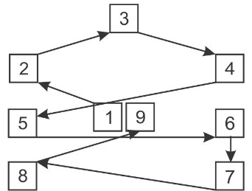
7 channel spectral video
Total of 180 videos and 60 images
2 light sources
1 standard condition
3 unfavorable conditions

Slide 17
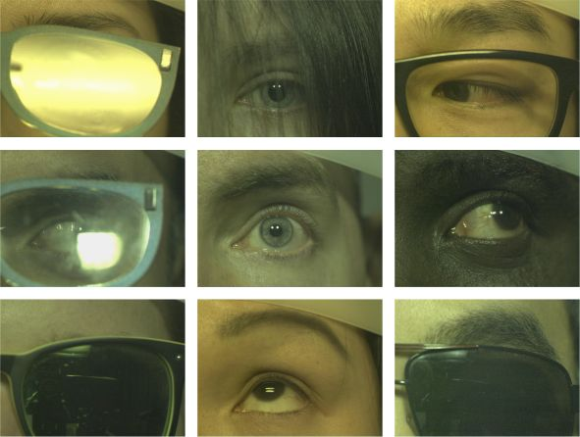
Unfavorable conditions

Slide 18
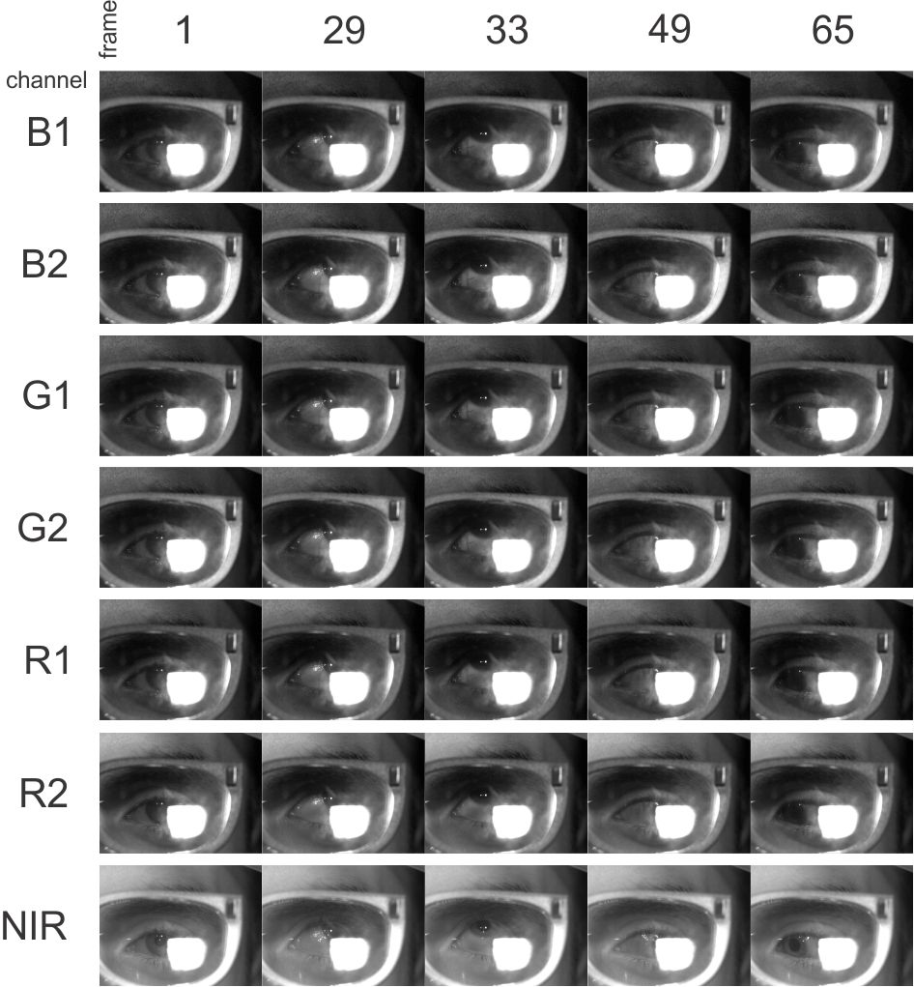
G2
G1

Slide 19
G2
NIR
Notes:
Traditionally, by using only NIR channel, tracking would fail due to the occlusion of pupil. With multi-channel tracking the fail could be compensated by searching for other features that are invisible in NIR but visible at other channels for example the capillaries

Slide 20
G2
NIR
Notes:
Traditionally, by using only NIR channel, tracking would fail due to the occlusion of pupil. With multi-channel tracking the fail could be compensated by searching for other features that are invisible in NIR but visible at other channels for example the capillaries

Slide 21
Just a few possibilities for future…
Stability of spectral signatures over time and motion
Optimization and image/video enhancement
Annotation and gaze interpretation
Pupil detection comparison

Slide 22
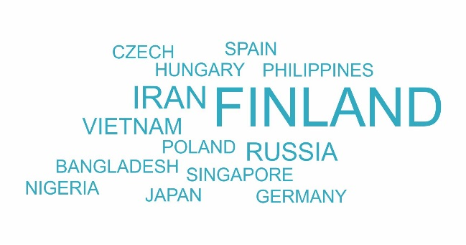
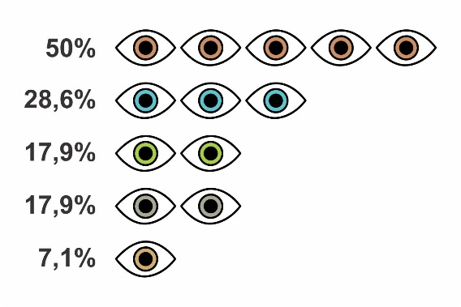
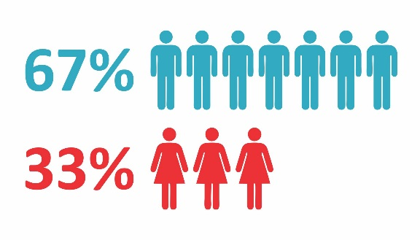
Database Summary
2 light sources
1 standard condition
3 unfavorable conditions
TOTAL:
180 multispectral video
and 60 multispectral images
1 light sources
1 standard condition
TOTAL:
30 hyperspectral images
Notes:
14 nationalities
5 eye colors

Slide 23

Thank you!
uef.fi

